Slide 1
Making Games of the JavaScript Variety
goldenPiGames

Slide 2



Blatant, but hopefully not excessive, self-promotion
@goldenPiGames
Twitter is an awful company that intentionally tries to get its users addicted to political witch-hunts, doomscrolling, and other harmful habits so that they spend more time on the site but anyway I’m @goldenpigames1
/ErnbtbJ

Slide 3
History of JavaScript
a completely ordinary PowerPoint presentation

Slide 4


1995: JavaScript is Created (1/4)
We need a scripting language for Netscape Navigator.
uh okay
Brendan Eich*
Netscape
*Brendan Eich is also a huge homophobe so maybe don’t toot his horn so to speak

Slide 5
1995: JavaScript is Created (2/4)
I made this language.
I call it “LiveScript”
Let’s call it JavaScript instead
Why?
Brendan Eich
Netscape
Java is really popular right now.
It’ll bring in the investors and stuff

Slide 6
1995: JavaScript is Created (3/4)
I hope our decision to name our programming language after a completely different programming language doesn’t cause huge amounts of unnecessary confusion down the line
Brendan Eich
Netscape

Slide 7
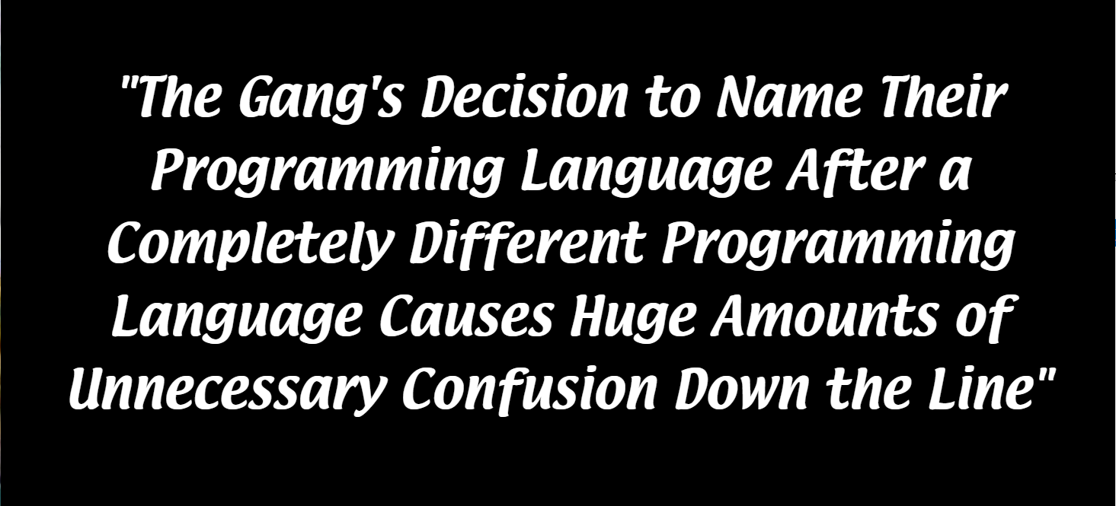

Slide 8

1996: JScript is Created (1/5)
This JavaScript thing is pretty cool, we should make something like that

Slide 9

1996: JScript is Created (2/5)

Slide 10
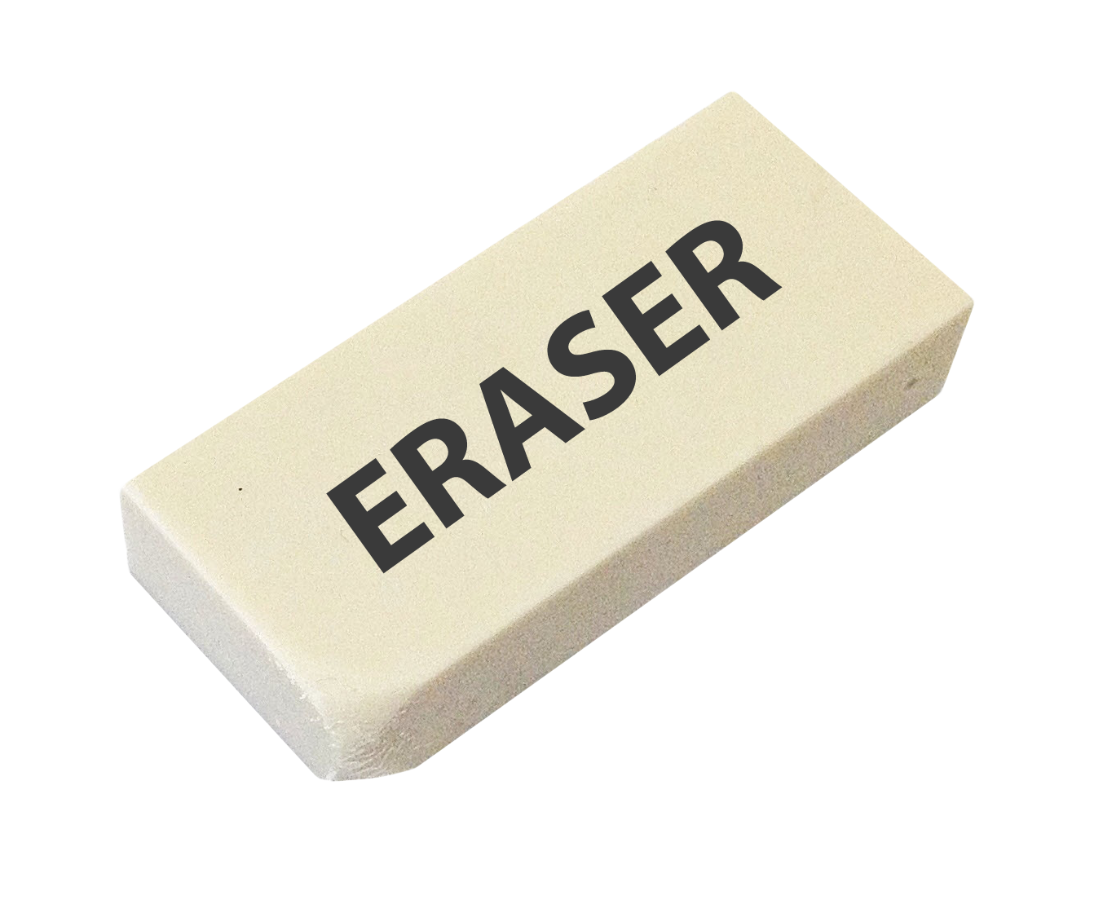
1996: JScript is Created (3/5)

Slide 11
1996: JScript is Created (4/5)

Slide 12
1996: JScript is Created (5/5)
Perfection.

Slide 13

2005: ActionScript 3 almost becomes ECMAScript 4 (1/4)
I hate having to make different scripts for each browser, can’t we have like an open standard?

Slide 14

2005: ActionScript 3 almost becomes ECMAScript 4 (2/4)
Good idea, anyone got any thoughts on it?

Slide 15



2005: ActionScript 3 almost becomes ECMAScript 4 (3/4)
Let’s use ActionScript 3, which is currently being developed for use with Flash

Slide 16
2005: ActionScript 3 almost becomes ECMAScript 4 (4/4)
nah

Slide 17
2009: JavaScript becomes standard as ECMAScript 5 (1/5)
I hate having to make different scripts for each browser, can’t we have like an open standard?

Slide 18



2009: JavaScript becomes standard as ECMAScript 5 (1/5)
uh, sure, let’s try using JavaScript this time

Slide 19

2009: JavaScript becomes standard as ECMAScript 5 (3/5)

Slide 20
2009: JavaScript becomes standard as ECMAScript 5 (4/5)
Great, now there won’t be any more stupid and pointless problems with web development

Slide 22
TL;DR
things happened
now we have a scripting that works on different browsers

